Slide 1

Ethiopian Airline Group Internship Report
Manager group Electromechanical Maintenance
University Name: Addis Ababa Science and Technology University
Supervisor: Mr. Muluken Abate
Internship Period: July 01 – Sept 30
Prepared By: Bezawit Denbeze

Slide 2



Outline
Introduction of The Hosting Company
Internship Experience
Industrial Project and Its Design Process
Overall Internship Achievement and Experience
Recommendation and Conclusion

Slide 3
Introduction of The Hosting Company

Slide 4

Company Profile
Addis Ababa Bole International Airport is located about 6 kilometers southeast of the city center of Addis Ababa, the capital of Ethiopia
It houses a state-of-the-art maintenance hangar that spans 7,200 square meters with a height of 25 meters, capable of accommodating a Boeing 747-400 or two Boeing 737-700 aircraft, or similarly sized aircraft, at any given time in various configurations
Ethiopian Airlines operates one of the most advanced maintenance bases in Africa, providing full air-frame maintenance up to D-check, engine overhauls, and component repair and refurbishment

Slide 5

Background of the company
History of The Company
Founded in 1945 to connect Ethiopia with the world.
First flight in 1946 with a Douglas DC-3, focusing on regional African routes.
Expanded in the 1960s-70s with Boeing 720/727, reaching Europe, Asia, and North America. Addis Ababa Bole Airport became its hub.
Despite challenges in the 1980s, added Boeing 737/757, improving connectivity.
1990s-2000s: Major modernization under CEO Girma Wake, acquiring Boeing 767 and expanding globally.
Joined Star Alliance in 2010, boosting international access.
Expanded fleet with Boeing 787 and Airbus A350 in the 2010s.
Today, it's a leading African airline, continuing fleet expansion and global reach.

Slide 6



2. Company’s Vision, Mission and Value
Mission
Vision
Aiming to become Africa’s leading and most competitive aviation group by 2025.
Focused on providing safe, customer-centric, and market-driven services.
Expanding across passenger and cargo transport, aviation training, flight catering, MRO, and ground services.
Become Africa’s leading aviation group with safe passenger and cargo services.
Deliver superior value as the preferred airline, employer, and investment choice
Support socio-economic development through corporate responsibility and global connectivity.
Value
Safety First
Innovation & Learning
Adaptability to Change
Employee Recognition
Integrity & Respect
Results-Oriented
Efficiency
Customer Care
Inclusivity

Slide 7

Products and Services
Passenger Transport: Domestic and international flights with various classes (Economy, Business).
Cargo Services: Comprehensive air freight solutions for time-sensitive shipments.
Aviation Training: Pilot and crew training through Ethiopian Airlines Aviation Academy.
Flight Catering: In-flight meal services offering local and international cuisine.
Maintenance, Repair, and Overhaul (MRO): Aircraft maintenance and repair services.
Ground Services: Passenger handling, baggage services, and airport operations.
Loyalty Program: ShebaMiles rewards program for frequent flyers.

Slide 8

Internship Experience

Slide 9




Activities
Motor Controller Installation: Managed wiring and configured soft starters for high-power motors.
Maintenance & Repair: Diagnosed and repaired various equipment, including:
Capacitor start induction motors
Water pump motors
Office fans
System Integration: Installed power lines and controllers, performed grounding setups, and conducted rigorous testing for operational efficiency.
Workspace Improvement: Organized cables, installed new lighting, and enhanced workplace safety and functionality.
Industrial Insights: Gained knowledge through visits to electroplating and metal finishing facilities, learning about operations and waste treatment processes.

Slide 10

Challenges Faced and Overcome During Internship Tasks
Complex Installations: One major challenge was the installation of motor controllers and soft starters for high-power motors
Diagnostic Difficulties: Diagnosing and repairing faults in various equipment, such as capacitor start induction motors and water pump motors, presented difficulties
System Integration Issues: Integrating new components with existing systems sometimes led to compatibility issues
Workspace Organization: Organizing a large workspace, especially when dealing with extensive cabling and equipment, posed challenges
Grounding Problems: Identifying and resolving grounding issues, particularly with the rectifier for the silver-plating machine, proved challenging

Slide 11

Industrial Project and Its Design Process

Slide 12
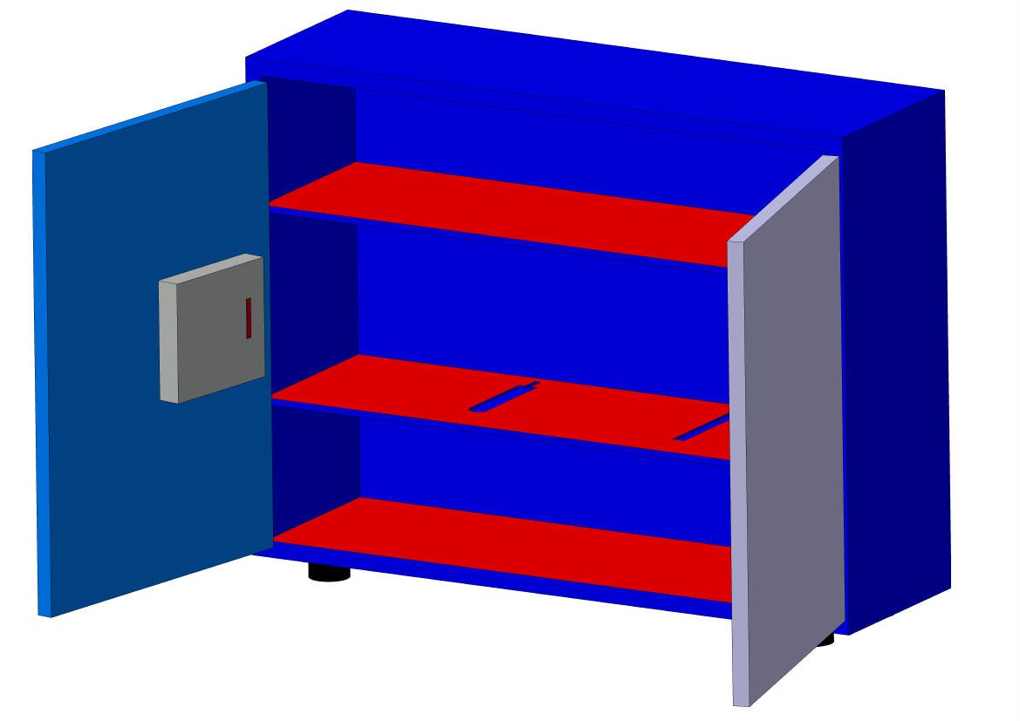
RFID-BASED TOOL TRACKING SYSTEM
The RFID-Based Tool Tracking System is designed to improve the management and accountability of tools within a cabinet, ensuring that each tool is tracked when borrowed and returned
The system leverages RFID technology, using the RFID RC522 module to scan RFID tags or cards assigned to both the tools and the individuals borrowing them
This system ensures that staff members are accountable for the tools they use, improving workflow efficiency in maintenance and repair environments

Slide 13

Background Analysis
RFID technology has gained prominence in various industries for asset tracking and management, offering a more streamlined solution compared to traditional methods
Tool management is a critical aspect of maintenance, repair, and operational environments, where multiple personnel handle various tools daily
The rise of RFID technology presents a modern solution to these issues, offering a reliable way to track and manage tools in real-time
This project focuses on addressing these challenges by integrating RFID technology with additional components, such as ultrasonic sensors, an LCD display, and a servo-controlled locking mechanism

Slide 14
Objectives
Secure Tool Cabinet with Servo-Controlled Locking: To incorporate a servo motor for locking and unlocking the tool cabinet based on the RFID scan, ensuring that tools are securely stored when not in use
Implement a Notification System: To integrate a buzzer that activates when a tool is not returned within a specified time, providing an immediate alert to the user and enhancing accountability
Improve Tool Management Efficiency: To reduce manual tracking and paperwork by automating the tool tracking process, ensuring more accurate and efficient management of tools within the maintenance and repair operations

Slide 15

Problem
Current challenges
Manual tool tracking system is time-consuming and prone to errors.
Misplaced or unreturned tools lead to delays and increased operational costs.
Lack of accountability makes it difficult to monitor who has borrowed a tool and its return status.
consequences
e
Delayed maintenance activities due to missing tools.
Increased operational costs and reduced productivity.
Risks to safety and interruptions in critical maintenance tasks.

Slide 16

Literature Review
RFID technology has revolutionized asset tracking and inventory management across various industries
According to the literature, RFID systems utilize electromagnetic fields to automatically identify and track tags attached to objects
RFID offers significant advantages over traditional barcode systems, including the ability to read multiple tags simultaneously and the capability to function in various environmental conditions
RFID-based systems have been shown to enhance the efficiency of tracking tools, reduce errors, and minimize losses
RFID systems could streamline tool tracking processes in industrial settings, providing real-time data on tool availability and usage

Slide 17

Design approach/Methodology

Slide 18
Step to develop the project
Requirements Analysis: Begin by identifying the specific requirements for the system, such as the number of tools to be tracked, the types of RFID tags and readers to be used, and the components needed
Component Selection: Choose the necessary hardware components for the system
Circuit Design and Assembly: Design the electrical circuit to connect the RFID module, ultrasonic sensor, LCD display, servo motor, and buzzer
Programming the Microcontroller: Write the code to integrate all components, enabling the RFID system to scan tags, the ultrasonic sensor to detect tool movement, the LCD to display borrower information, and the servo motor to control the locking mechanism

Slide 19
Step to develop the project
Testing the System: After assembling the hardware and writing the code, test the system by simulating various scenarios
Prototype Refinement: Based on testing, make necessary adjustments to improve system performance and reliability
Final Integration and Presentation: Once the prototype functions as intended, integrate all components into a compact form for practical use

Slide 20
System design and architecture
RFID Tags/Cards: At least two RFID tags or cards will be attached to the tools or issued to users for identification
Ultrasonic Sensor : This sensor detects the presence or absence of a tool by measuring the distance between the sensor and the tool in the cabinet
16x2 LCD Display : The LCD will display essential information, such as the name of the borrower, tool status, and alerts
Servo Motor : A small servo motor is used to operate the door lock mechanism
Buzzer: This component is used to generate an audio alert when a tool is not returned within a specified period, helping to improve accountability and notifying users of overdue tools

Slide 21

Control system
Arduino Uno
Acts as the brain, it integrates the input of RFID and Ultrasonic sensor and controlling outputs of LCD, servo motor, and buzzer

Slide 22
Communication
The component communicates via digital pins and libraries
The RFID system interface with the microcontroller through the SPI Protocol and other components use standard GPIO pins

Slide 23
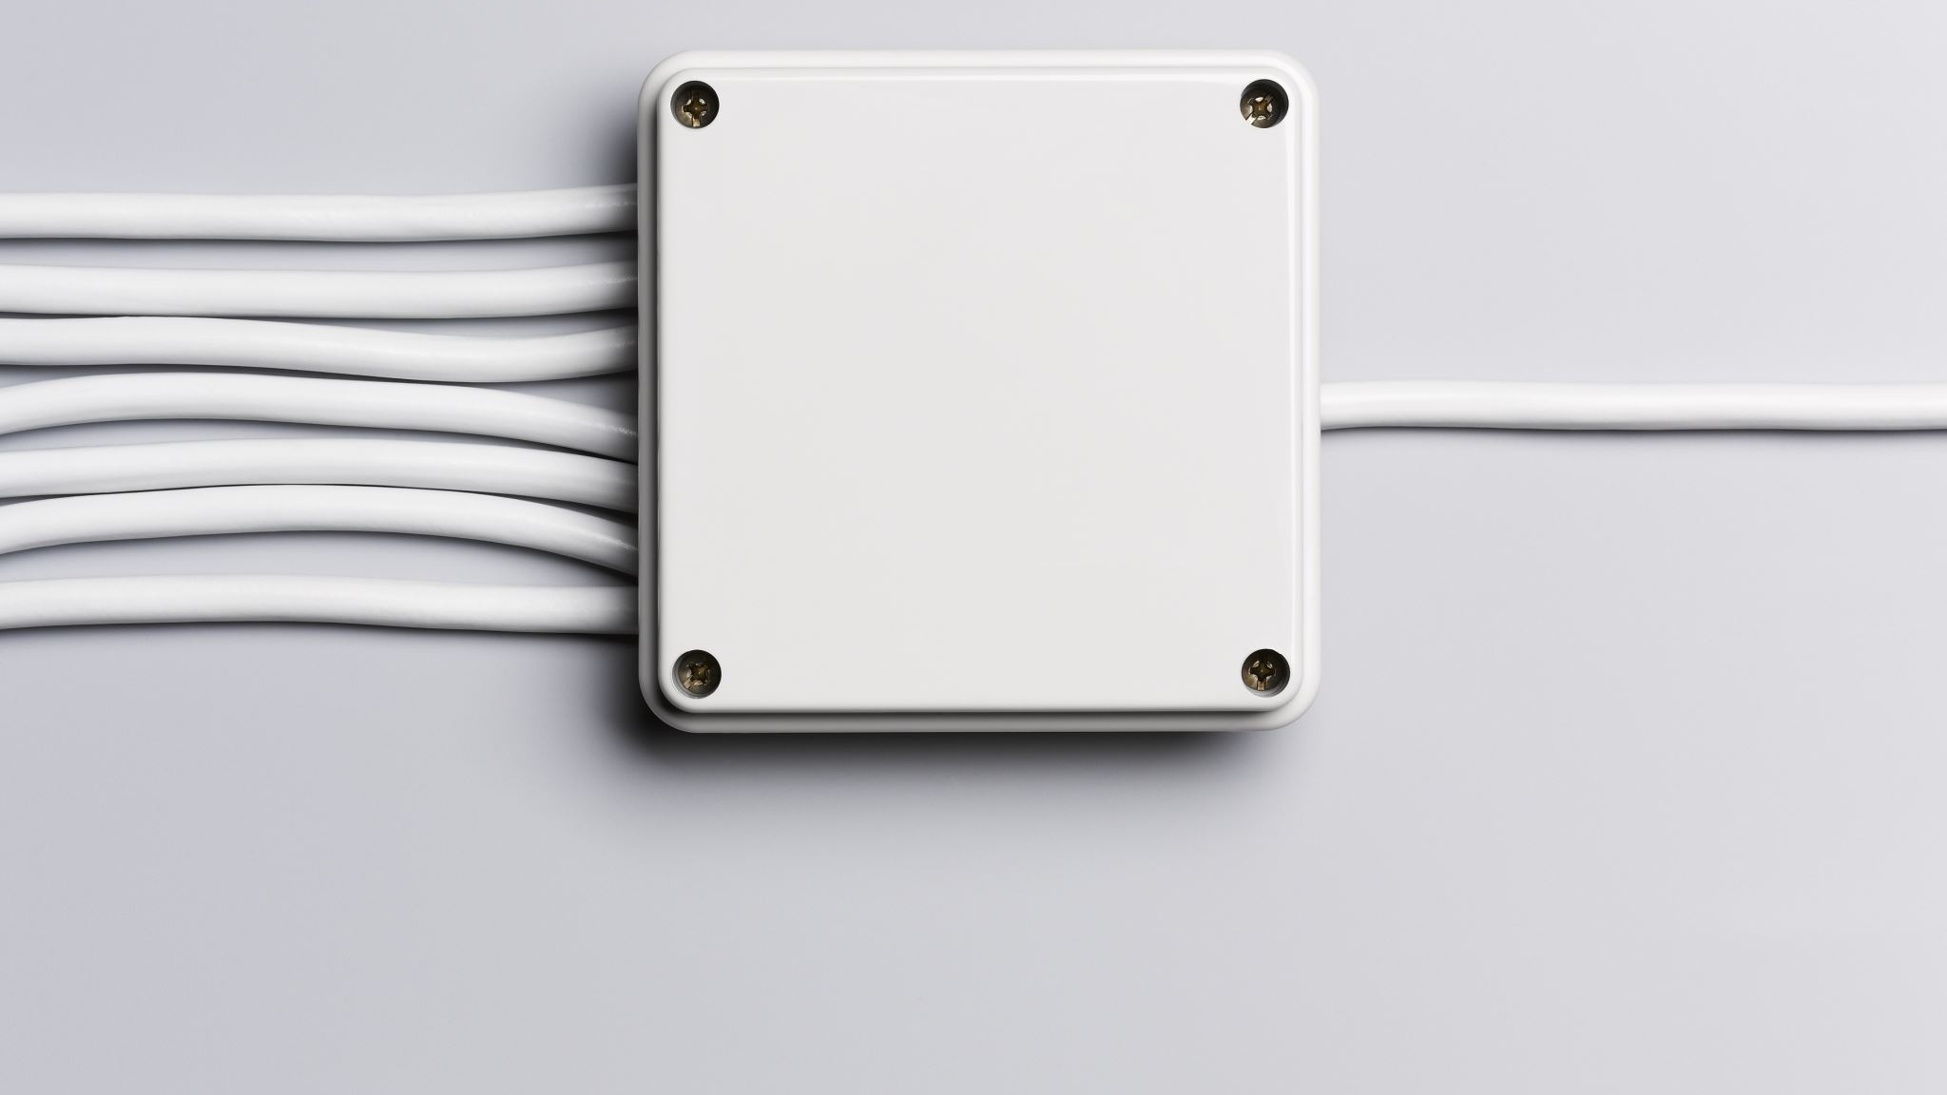
Energy and power consideration
5v or 3.3v power supply are used for each component with careful consideration for current requirement
User interface and interaction
when an RFID tag is scanned the system verifies the user’s Id, opens the door, and track the borrowing and return process
If a tool is not returned, the system triggers the buzzer and display an alert, notifying the borrower’s name which can be further extended to alert a supervisor

Slide 24

Mathematical design
The calculation mainly related to power, timing, and sensor range

Slide 25
Power consumption
Arduino operates at 5v
LCD 16*2 consume around 30mA
RFID module operates at 3.3v and consume around 13-26mA
Servo motor consumed power based on torque, typically it can use 100- 250 when moving
Ultrasonic sensor draw about 15mA
Buzzer usually draws around10-20mA

Slide 26
Timing calculation for the servo motor
The servo motor open and close the cabinet door, which depends on the angle of rotation
The servo motor uses Pulse Width Modulation to position its shaft
The typical signal is a pulse that ranges between 1ms to 2ms and sent every 20ms

Slide 27

Ultrasonic sensor distance calculation
Ultrasonic senor measures the distance by sending sound waves and calculating the distance it takes for the echo to return Distance = Where: distance1 = duration1 * 0.034 /

Slide 28
Voltage divider for buzzer with Transistor
Transistor current gain ≈ 100
Buzzer operating current ≈ 15mA

Slide 29

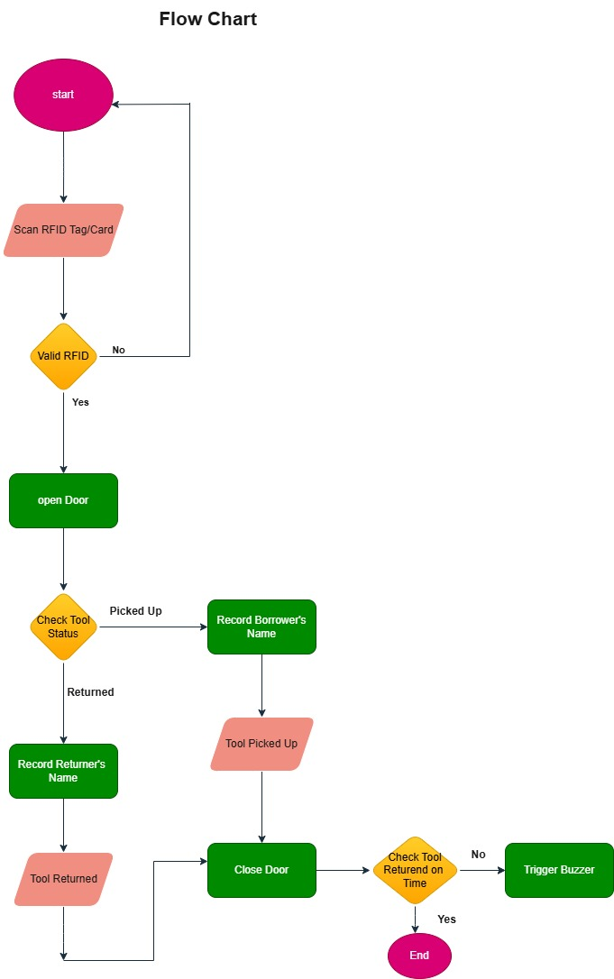
Flow chart

Slide 30

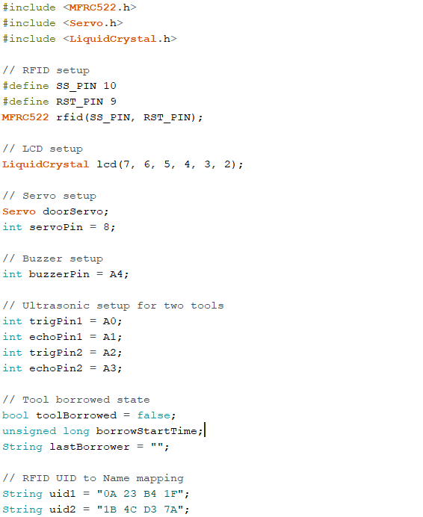
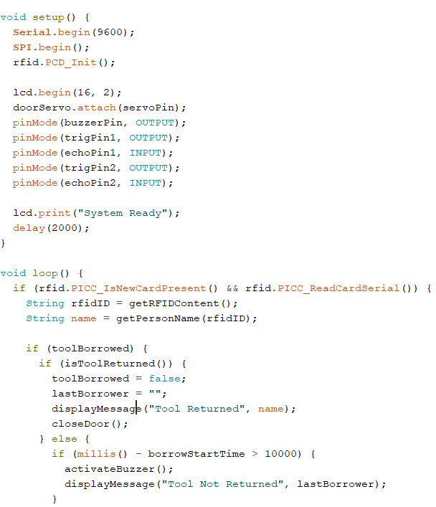
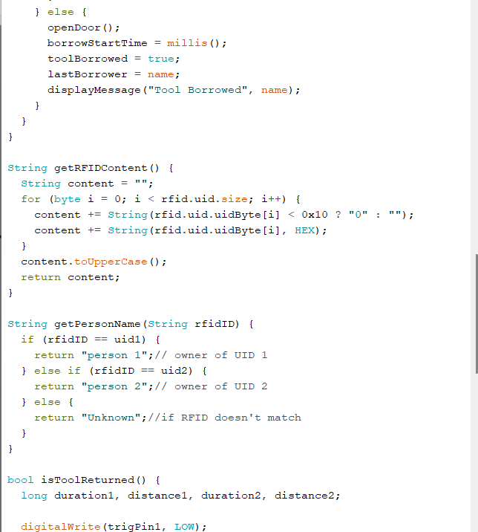
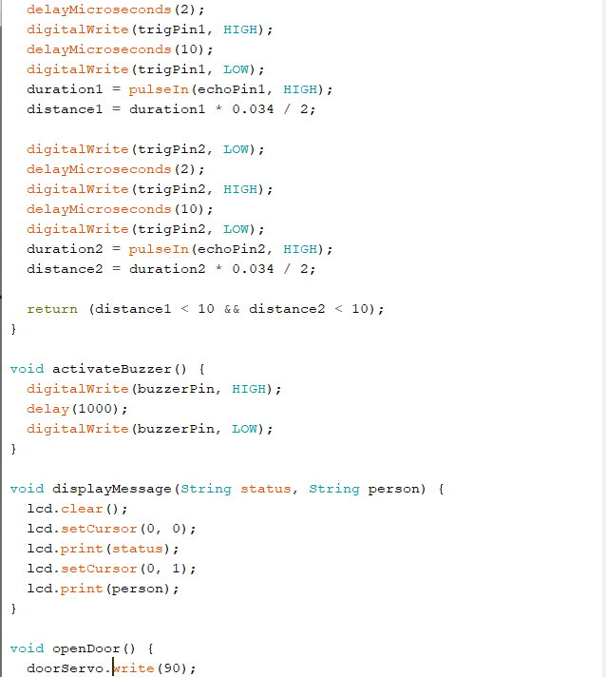
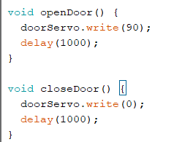
Code

Slide 31
Overall Internship Achievement and Experience

Slide 32
Overall internship achievement and experience
Practical Experience: Hands-on experience with industrial systems, including motor control, wiring, and maintenance, which enhances theoretical knowledge
Technical Skills: Improved skills in troubleshooting, repairing, and testing various equipment such as motors, controllers, and heaters
Project Management: Experience in managing and completing projects, including installations and repairs, which helps in planning and execution
Problem-Solving: Developed problem-solving skills through diagnosing and resolving equipment issues, which is crucial in engineering
Industry Insight: Gained understanding of industrial processes and operations, such as plating and chemical treatments, through visits and practical work

Slide 33
Recommendation and Conclusion

Slide 34
Recommendation
The internship provided a solid foundation, and advancing my knowledge will enhance my capabilities in managing complex systems and projects
Implement a rigorous documentation process for all tasks, including detailed records of repairs, installations, and problem-solving approaches
Actively engage in building and maintaining professional relationships with colleagues, supervisors, and industry professionals
Regularly seek feedback from mentors and peers to identify strengths and areas for improvement
Participate in project management activities, including planning, scheduling, and resource allocation

Slide 35
Conclusion
The internship at Ethiopian Airlines has been an exceptionally valuable experience, providing extensive practical knowledge in electrical and control engineering
Throughout the internship, you effectively engaged in various tasks, including motor repairs, power line installations, and system maintenance, which have significantly enhanced your technical and problem-solving skills
The RFID-based tool-tracking project demonstrated capability to apply theoretical knowledge to practical solutions

Slide 36
THANK YOU

